Slide 1


PeerForward
Digital Curriculum Training
2022-23 School year

Slide 2
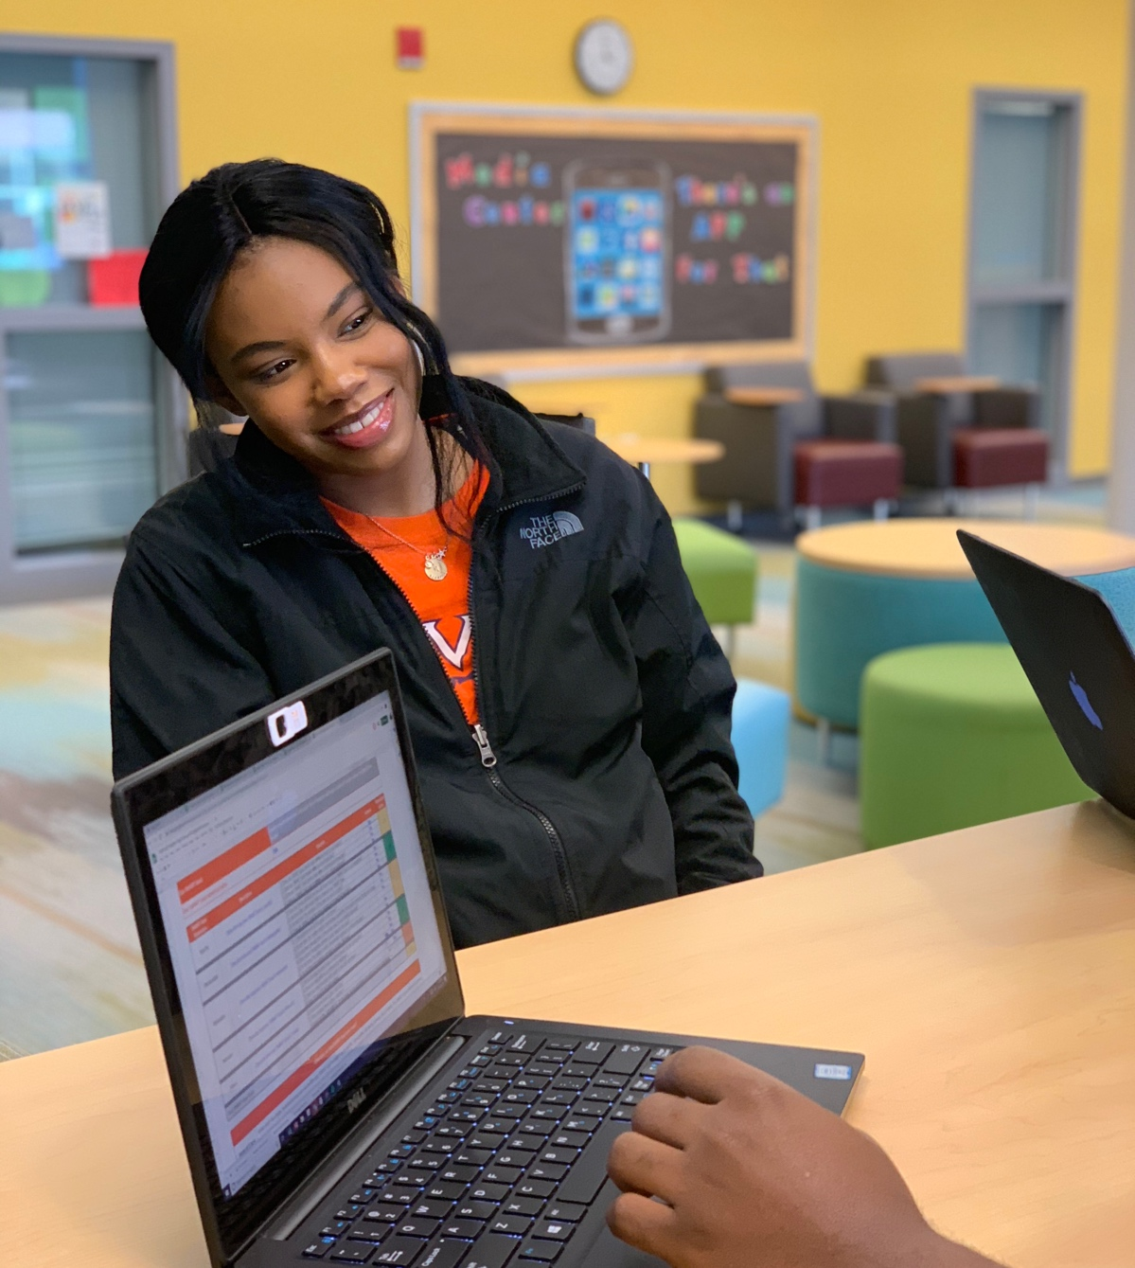
TABLE OF CONTENTS
Welcome and Introduction
Core Understandings: Provides a description of the skills that the curriculum aims to develop in all students grades 9-12
Digital Curriculum Goals and Major Assessments, by Grade Level: Outlines the larger goals of each grade level book and the key assessments within each book
Content & Highlights of the Curriculum: Provides an overview of the structure and content of the curriculum, and describes the unique tools and features of the curriculum
Updates to the Curriculum: Outlines the updates to the curriculum
Tips for Implementing the PeerForward Curriculum: Offers suggestions for implementing the curriculum in your school
Getting Started: Describes how to begin use of the PeerForward Curriculum

Slide 3
Welcome
Welcome to PeerForward’s Navigator and Launch Curriculum!
This Navigator and Launch digital curriculum is designed to prepare students for college and career in the 9th-12th grades.
This easy-to-use digital curriculum is divided into four educator books (one for each grade), that includes over 30 lesson plans and corresponding handouts that can be printed and distributed to students.
The goals of the curriculum are to:
Help students understand the relevance of high school to their current and future lives and to envision high school as a launchpad to college and career success.
Help students master PeerForward’s Core Understandings that will allow them to succeed in postsecondary planning and in college and career training after high school.

Slide 4
PeerForward Curriculum
  The Navigator, a curriculum for senior-level classrooms, is designed to walk seniors through the entire college application and enrollment process.
  Launch, a 9-11 grade curriculum, is designed to build student mastery of five core college-going understandings.

Slide 5

Core Understandings

Slide 6

Core Understandings
The Curriculum’s Core Understandings are in alignment with college and career readiness standards set forth by the American School Counseling Association and Common Core.
  Self-Advocacy
  Academic Excellence
  College-Career Connection
  College 101
  Financial Awareness

Slide 7
Curriculum Goals & Major Assessments

Slide 8
9th Grade: Clean Slate
Goals of 9th Grade Curriculum:
Help students make a smooth transition to high school
Help students make positive choices today that will set them up for success tomorrow
Major Assessments:
High School Academic Planning
Study Skills
Life Roadmap
Career Research
College Research
Long-term Savings Plan

Slide 9
10th Grade: Speak Up
Goals of 10th Grade Curriculum:
Students explain who they are, where they come from, and where they want to go
Students express themselves in writing, speaking, and other forms of communication
Students use strategies to overcome a variety of academic, professional, and personal barriers
Major Assessments:
High School Academic Planning
PSAT or ASPIRE Test
Community Advocacy
Career Research
Mock Job Interview
Mock College Fair
Researching Career and College Costs vs Earning Potential

Slide 10
11th Grade: Take Action
Goals of 11th Grade Curriculum:
Students articulate their next steps after high school graduation
Students maximize their 11th grade experience
Students take action to set themselves up for a successful senior year
Major Assessments:
Postsecondary Planning
High School Academic Planning
Letters of Recommendation
Draft Personal Statement
ACT or SAT Test
Draft College List
Personal Financial Portfolio
Resume

Slide 11
11th Grade: Take Action
Goals of 12th Grade Curriculum:
Students explore, apply to, and prepare for a variety of postsecondary options
Students prepare for the transition to life after high school
Students focus on goal-setting, planning, taking action, and reflecting
Major Assessments:
Postsecondary Planning
High School Academic Planning
College List
Resume
Personal Statement
College Applications
FAFSA
Scholarship List
Making an Informed Decision

Slide 12
Content & Highlights

Slide 13
Contents
In the beginning of each book, you will find a roadmap with all of the units covered in the curriculum. The months indicated on this roadmap are suggested timeframes.
A scope and sequence chart, provided at the beginning of each book outlines the assessments, outcomes, and objectives for each lesson. These are suggetions and can be tailored to fit the needs of your particular group of students.
Prior to each lesson, you will find a header page with the learning objectives, assessments (if applicable), materials, PeerForward Core Understandings, and necessary preparation steps.
Each lesson plan includes a suggested lesson procedure with dynamic activities for students.

Slide 14
Contents, cont’d
Many lessons include tips for extending the lesson, suggestions for differentiated learning, as well opportunities for reflection that ask students to reflect upon that given topic or activity.
Some lessons include best practices that can provide additional support in carrying out the lesson.
Following each lesson procedure, you will find corresponding handouts for students or reference materials to carry out the lesson. These handouts are specific to the grade level selected.
At the end of the each Ebook is a glossary that provides a list of terms found throughout the curriculum.

Slide 15



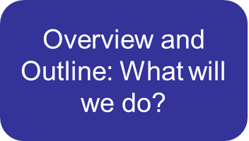

Lesson Plan Overview
Objectives: What will we learn?
Assessments: Did we meet our objectives?
Lesson Extension: What else can we do and learn?

Slide 16
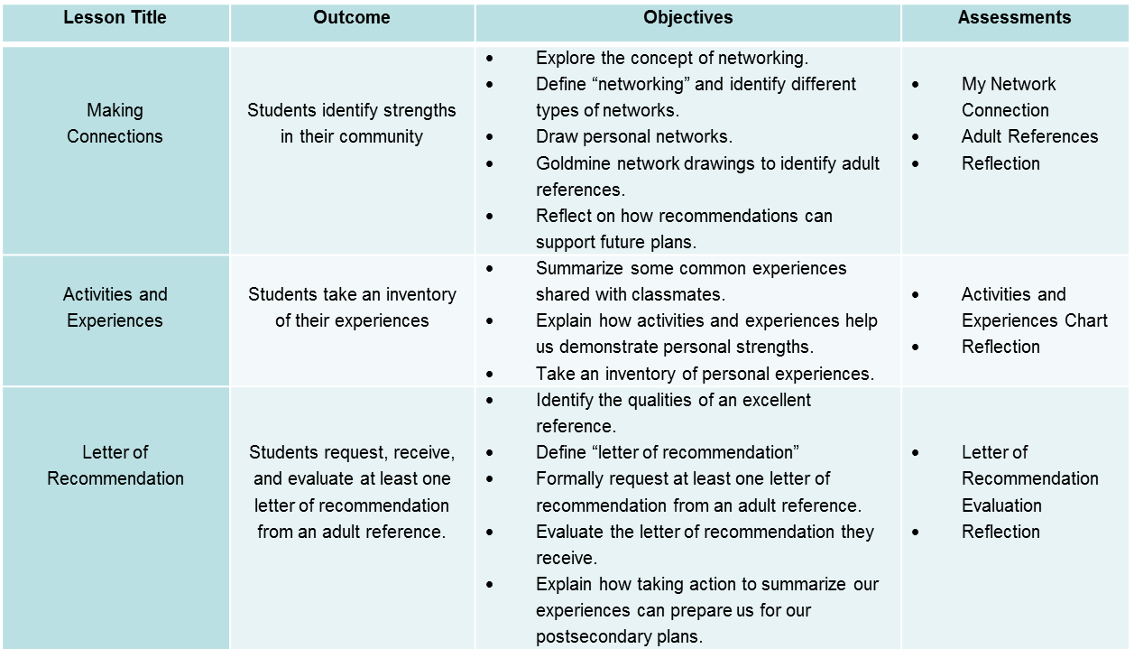
Scope & Sequence
Outlines the year’s learning objectives and outcomes for educators

Slide 17
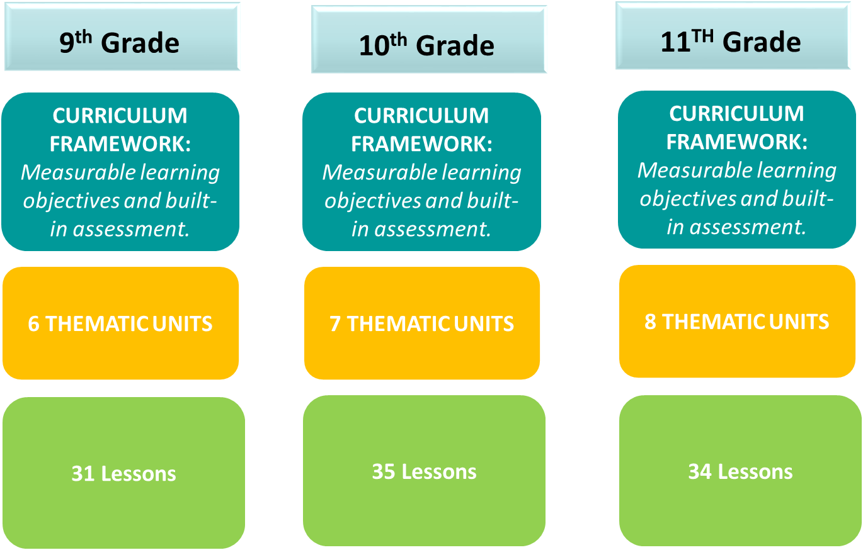
Highlights
Lessons can be done on a weekly basis. Based on the number of lessons provided, as an educator, you may extend lessons as needed to cater to a yearlong course or a semester-long course.

Slide 18
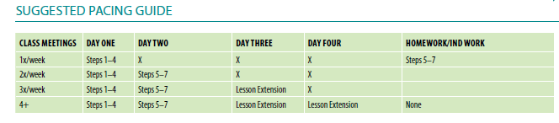
Highlights, cont’d
12th Grade
Senior Portfolio: Along the way, students create meaningful products they can use now and in the future.
Senior Portfolio Checklist: provides an outline of all the important documents and items that are needed for postsecondary success.
CURRICULUM FRAMEWORK:
Measurable learning objectives and built-in assessment.
7 THEMATIC UNITS:
Provide structure and flexibility
33 LESSONS:
Meaningful activity and outcomes engage all students
Based on the number of lessons provided, as an educator, you may repeat or extend lessons as needed to cater to a yearlong course or a semester-long course.
A pacing guide is provided at the beginning of each lesson in the Navigator for educators to determine how to pace the lesson depending on the number of times the class meets.

Slide 19
Recent Updates to the Curriculum

Slide 20
Changes to the Curriculum
Downloadable and Editable PDFs of Student Handouts
To support in-person, blended, and online learning environments, educators can now access and share student handouts in a variety of mediums. Either download and print the materials to distribute them in-person, or share the editable PDF virtually so that students can complete and submit the work from their computers.
Links are available on the “Handout Quick Links” page, or at the start of each lesson’s handouts.
Updated Test & FAFSA information:
Wherever mentioned, the ACT and SAT test dates reflect the current school year. All FAFSA information is also up-to-date by the time of publication (March).

Slide 21
Tips for Successful Implementation

Slide 22
Implementation Tips
Curriculum Lead
If your school or district has multiple educators teaching this curriculum, appoint a lead to serve as the expert. They should be able to share the links and access credentials for the curriculum, train educators on the curriculum, and provide additional support as necessary.
Collaboration
Work with other educators in the school teaching the curriculum to share best practices, determine a grading structure, and discuss ways to strengthen student engagement. By collaborating with other teachers, you can create systems or structures for the class and ensure students are engaged in the curriculum.

Slide 23
Implementation Tips
Flexibility
The curriculum can be implemented sequentially and/or in its entirety, or an educator can select a particular lesson or content area from the curriculum to focus on at any given time. (Note that in the Navigator, some lessons may be more time sensitive than others due to external deadlines). While some lessons are contingent on previous lessons most are structured so they can be taught on their own.
Leverage Peer Leaders
Particularly for the 12th grade text, the Navigator, there may be opportunities to align the work of the Peer Leader team with the content of the class. Encourage Peer Leaders to lead portions of the curriculum, or highlight related campaign events in class. Refer to the Playbook Alignment Guide for ideas.

Slide 24



Add’l Tips
For more information on implementation, best practices, and key lessons, see the introductory pages of
each grade level book.

Slide 25
Getting Started

Slide 26
Steps to Start
Step 1: You will receive an email with links to the online books, login information, and how to use the digital curriculum.
Step 2: Once you have access to the curriculum, you can download and save the books as a PDF so they are easily accessible on your computer or mobile device. Alternatively, you can return to the online version at any time.
Step 3: Review the curriculum to ensure you understand the format and structure
Step 4: Check out the introductory pages to answer any questions you might have.
Step 5: Remember, the handouts that follow each lesson procedure can be printed out or distributed electronically to your students.
Step 6: Have fun!

Slide 27

Questions?
Please contact:
digitalcurriculum@peerforward.org

